Slide 1

An Industry Oriented Mini Project Presentation On TECHNIQUE FOR LUNG DISEASE PREDICTION USING DEEP LEARNING
By KARTHIK J (21WJ1A7228)
AJAY POGULA (21WJ1A7251)
SANTOSH SRIRAMOJU (21WJ1A7260)
Under the Esteemed Guidance of
Ch Murali Krishna(Asst Professor-AI&DS)
Guru Nanak Institutions Technical Campus (Autonomous)

Slide 2
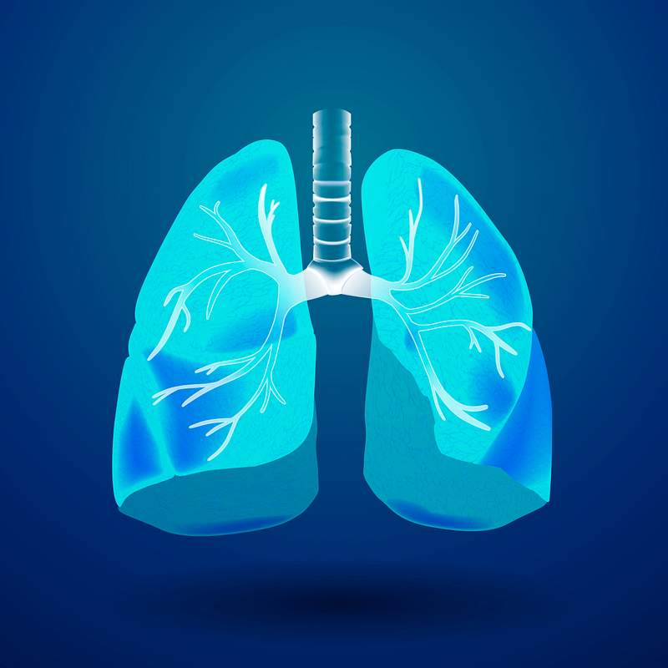
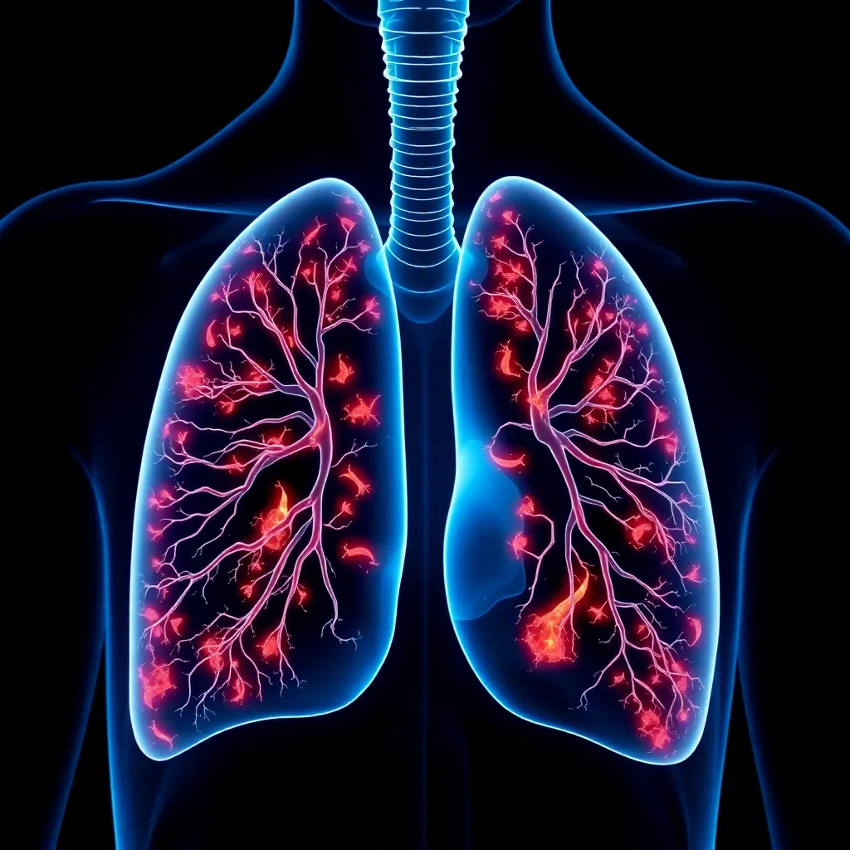

LUNG DISEASE
PREDICTION

Slide 3
OVERVIEW of the Presentation:-
Abstract
Objective
Introduction
Literature survey
Existing System
Proposed System
System Architecture
UML and Data Flow Diagrams
Conclusion

Slide 4
ABSTRACT:
The impact of disease on health is escalating quickly as a result of environmental changes, climate change, adjustments in lifestyle, and other reasons. The early detection of lung illness is important. Convolutional neural networks (CNNs), one type of existing deep learning approach, are used to forecast lung illness. As a result, we propose a novel deep learning framework for predicting lung diseases based on the VGG16 Architecture. The goal of this research is to develop a VGG16 architecture-based lung disease detection model. The VGG16 Architecture beats existing techniques for both whole and sample datasets in terms of measures including precision, recall, F1 score, and validation accuracy. Therefore, the proposed VGG16 Architecture will make it easier for both professionals and clinicians to detect lung problems.

Slide 5
OBJECTIVE:
Develop a deep learning model based on the VGG16 architecture for lung disease prediction.
Utilize X-ray images for the early detection and classification of lung diseases.
Enhance the diagnosis process for conditions such as COVID-19, tuberculosis, and pneumonia.
Achieve superior performance metrics like precision, recall, F1 score, and validation accuracy compared to existing systems.

Slide 6
INTRODUCTION:
Lungs play a vital role in the human system, which performs expansion and relaxation to bring in oxygen and take out carbon dioxide. Lung diseases are respiratory diseases that affect the various organs and tissues associated with breathing, leading to airway diseases, lung tissue diseases, and lung circulation diseases. Some of the respiratory diseases like common cold and influenza cause mild discomfort and hindrance while others like pneumonia, tuberculosis and lung cancer are life-threatening and cause severe acute respiratory problems.
According to a research study done by the Forum of International Respiratory Societies called “The Global Impact of Respiratory Disease,” 10.4 million people suffered mild or severe

Slide 7
INTRODUCTION:
symptoms of tuberculosis, and 1.4 million of those affected died as per the survey reported.
More than 1.6 million people were reported to have died in the year the survey was carried out.
Pneumonia is one of the top respiratory diseases and 1.23 million children under the age of 5
died due to pneumonia according Public Health report titled “Pneumonia and Diarrhea Progress
Report 2020” .
Chest X-ray images and CT scans are common examinations that determine the presence of
these diseases. The presence of trained professionals is required to examine the scanned images
and determine the infections

Slide 8
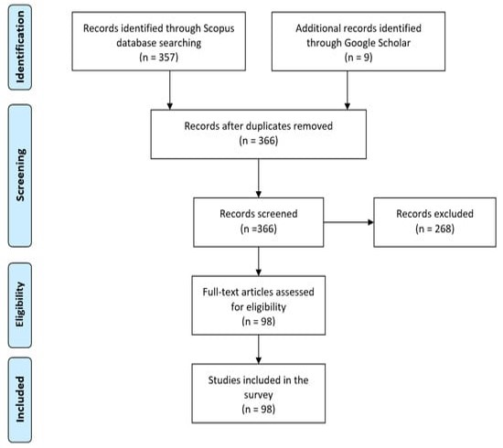
LITERATURE SURVEY-I:
Lung diseases remain a significant global health concern, necessitating efficient and accurate diagnostic tools. Recent advancements in deep learning have revolutionized medical imaging analysis, offering promising solutions for lung disease prediction.
This literature survey explores contemporary techniques in lung disease prediction using deep learning, focusing on various architectures, methodologies, and their effectiveness.
The application of deep learning, particularly through architectures like VGG16, has shown great promise in the prediction of lung diseases.

Slide 9
EXISTING SYSTEM:
CNN
CNN stands for Convolutional Neural Network. A type of deep learning algorithm that particularly effective for analyzing visual data like images and videos. CNNs are designed to automatically and adaptively learn spatial hierarchies of features from the input data through a process called convolution. This process involves sliding a filter or kernel over the input data to extract relevant features.
CNNs are widely used in various tasks such as image classification, object detection, image segmentation, and more. They have revolutionized fields like computer vision be achieving state-of-the-art performance in tasks that were traditionally challenging for machines, such as recognizing objects in complex scenes.
EXISTING SYSTEM DISADVANTAGES:-
Difficulty in classifying the lungs contain some degree of tilt or rotation.
Completely loses all the information about the composition and position of the components and they transmit that information further to a neuron which might not be able to classify the image.
Does not have co-ordinate frames which are a basic component of human vision.

Slide 10
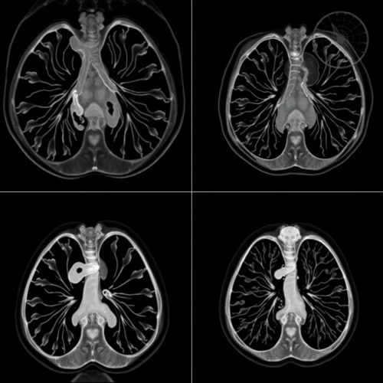
PROPOSED SYSTEM:
To diagnose diseases effectively, accurate tools are
essential. This project focuses on using X-ray
images and advancements in artificial intelligence
for lung disease prediction. The VGG16 dee
learning architecture is utilized to identify and
classify lung infections such as COVID-19,
tuberculosis, and pneumonia. AI and deep learning
have significantly improved the diagnosis and
classification of lung diseases in medical imaging.
This system aims to explore and classify various
lung infections, providing early detection to
enhance patient care. The research leverages
cutting-edge technology to assist healthcare
professionals with more accurate and efficient
diagnostics.

Slide 11
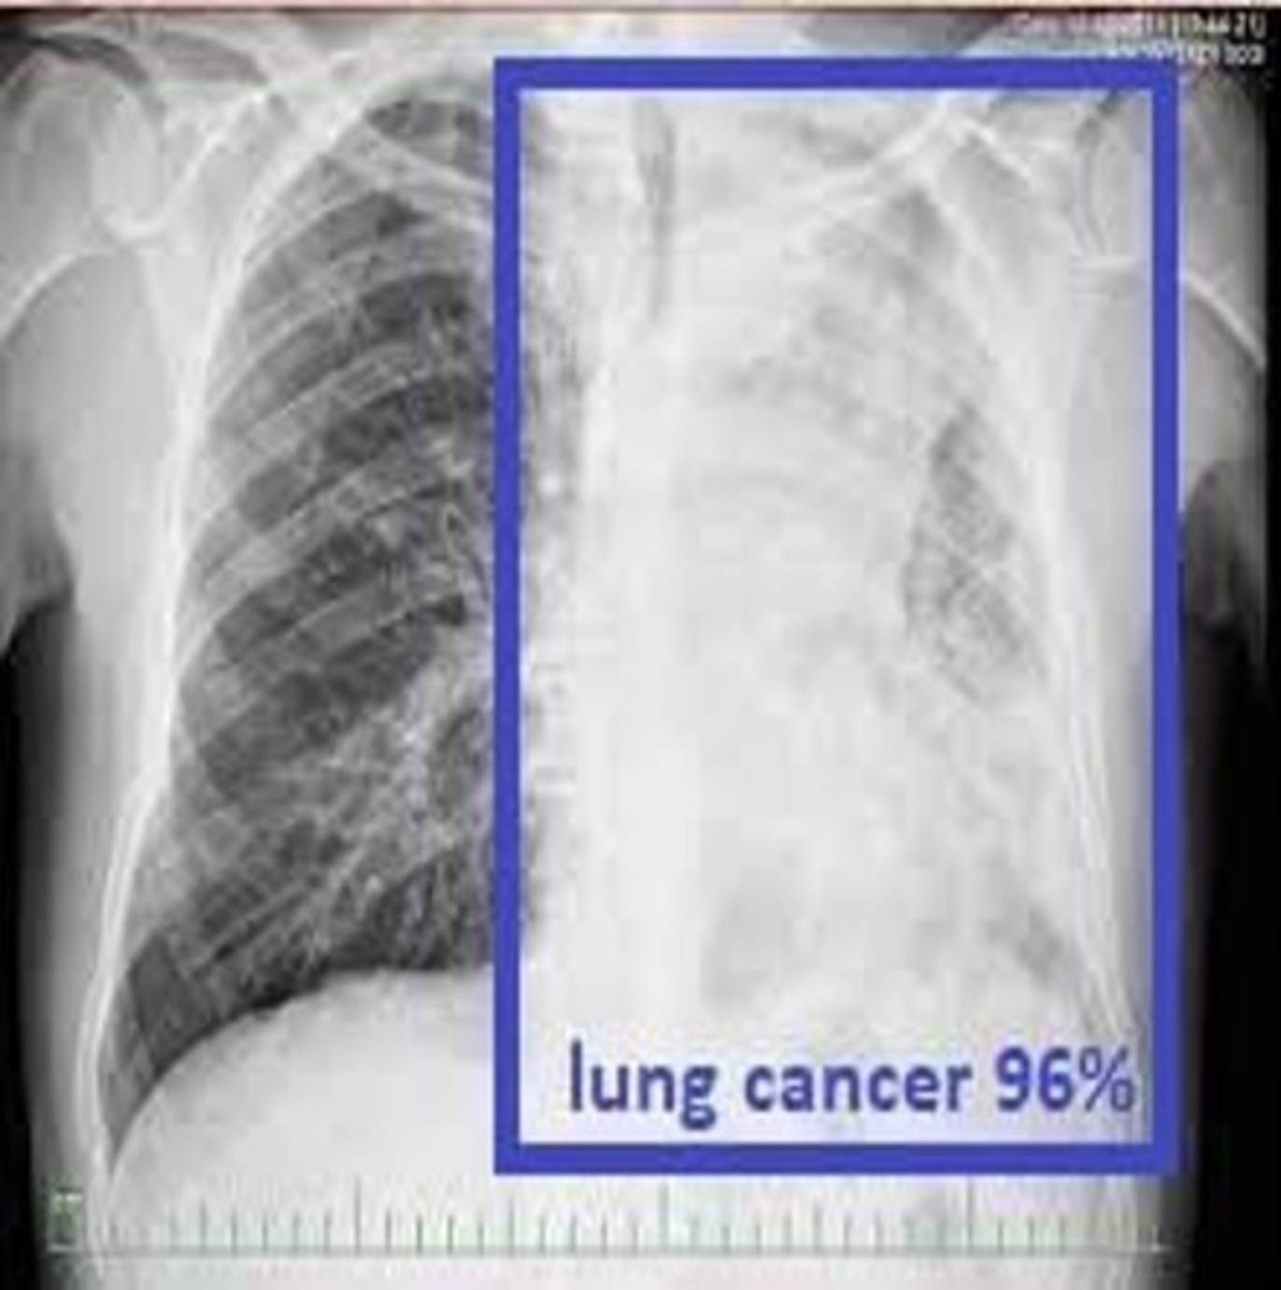
PROPOSED SYSTEM:
PROPOSED ALGORITHM:
VGG16
The VGG convolutional network is a model
with 16 layers trained on fixed size images.
The input is processed through a set of convolution
layers which use small-size kernels with a receptive
field 3x3.This is the smallest size allowing us to
capture the notion of up, down, right, left, and
center.

Slide 12
PROPOSED SYSTEM:
ALGORITHM DEFINITION: -
A Convolutional Neural Network (CNN) is a specialized deep learning model tailored for processing visual data like images and videos. Its architecture comprises layers designed to extract hierarchical features from input data. CNNs typically start with convolutional layers that apply filters to capture patterns and features, followed by activation functions like ReLU to introduce non-linearity. Pooling layers reduce spatial dimensions while retaining crucial information, enhancing computational efficiency and preventing overfitting.
VGG16, a specific CNN variant, gained fame for its straightforward yet effective design with 13 convolutional layers, 3 fully connected layers, and small 3x3 filters, making it ideal for image classification tasks. Its success lies in stacking convolutional blocks and utilizing max pooling to progressively learn intricate features. versatility extends to transfer learning, where pre-training on extensive datasets like ImageNet enables fine-tuning for specific applications, showcasing

Slide 13
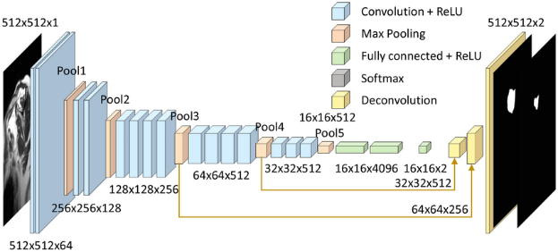
VGG16 ARCHITECTURE:

Slide 14
SYSTEM REQUIREMENTS:
HARDWARE REQUIREMENTS
PROCESSOR : Pentium i3 Processor
RAM : 2GB DD RAM
HARD DISK : 250 GB
SOFTWARE REQUIREMENTS
BACK END : PYTHON
OPERATING SYSTEM : WINDOWS 7
IDE : Spyder3

Slide 15
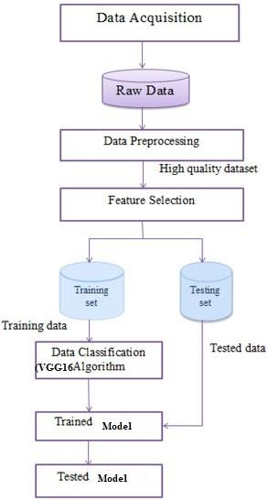
SYSTEM ARCHITECTURE:

Slide 16
UML DIAGRAMS
USE CASE DIAGRAM

Slide 17
CLASS ARCHITECTURE:

Slide 18
SEQUENTIAL DIAGRAM:

Slide 19
DATA FLOW DIAGRAM:
Lung Disease Dataset
User
Read Images & Pre- processing
Apply VGG16 Architecture & save trained file like TrainedModel.h5

Slide 20
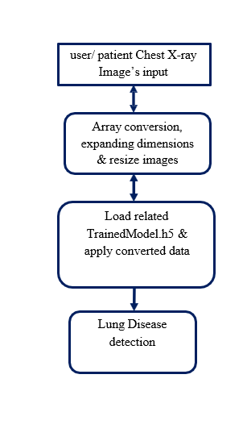
LEVEL-1:

Slide 21
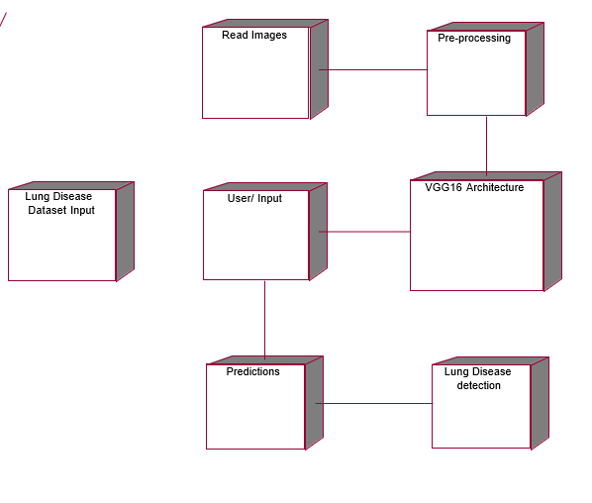
DEPLOYMENT DIAGRAM:

Slide 22
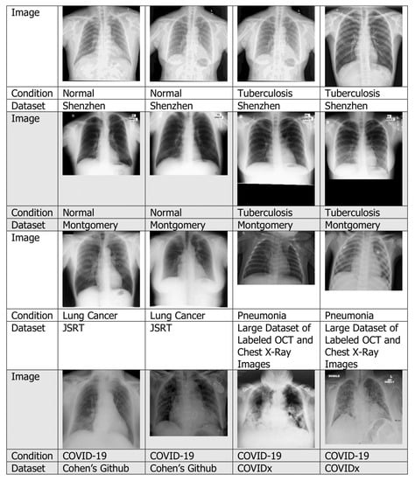
SNAPSHOT-1

Slide 23

SNAPSHOT-2

Slide 24
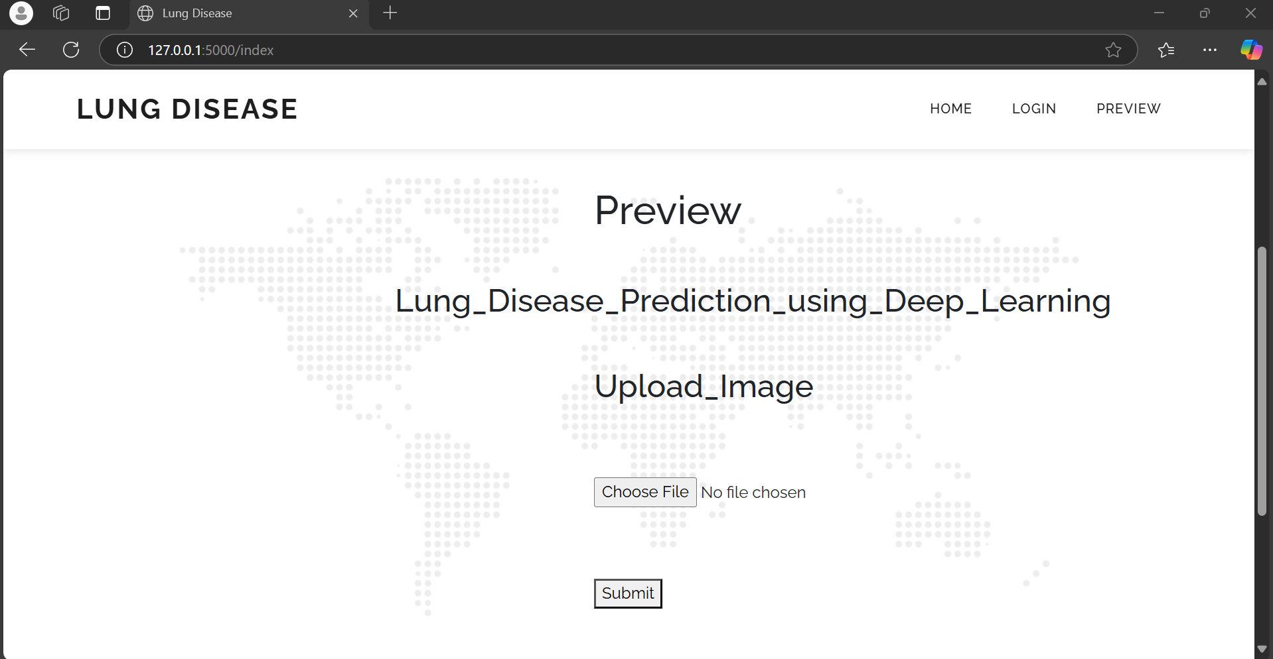
SNAPSHOT-3:

Slide 25
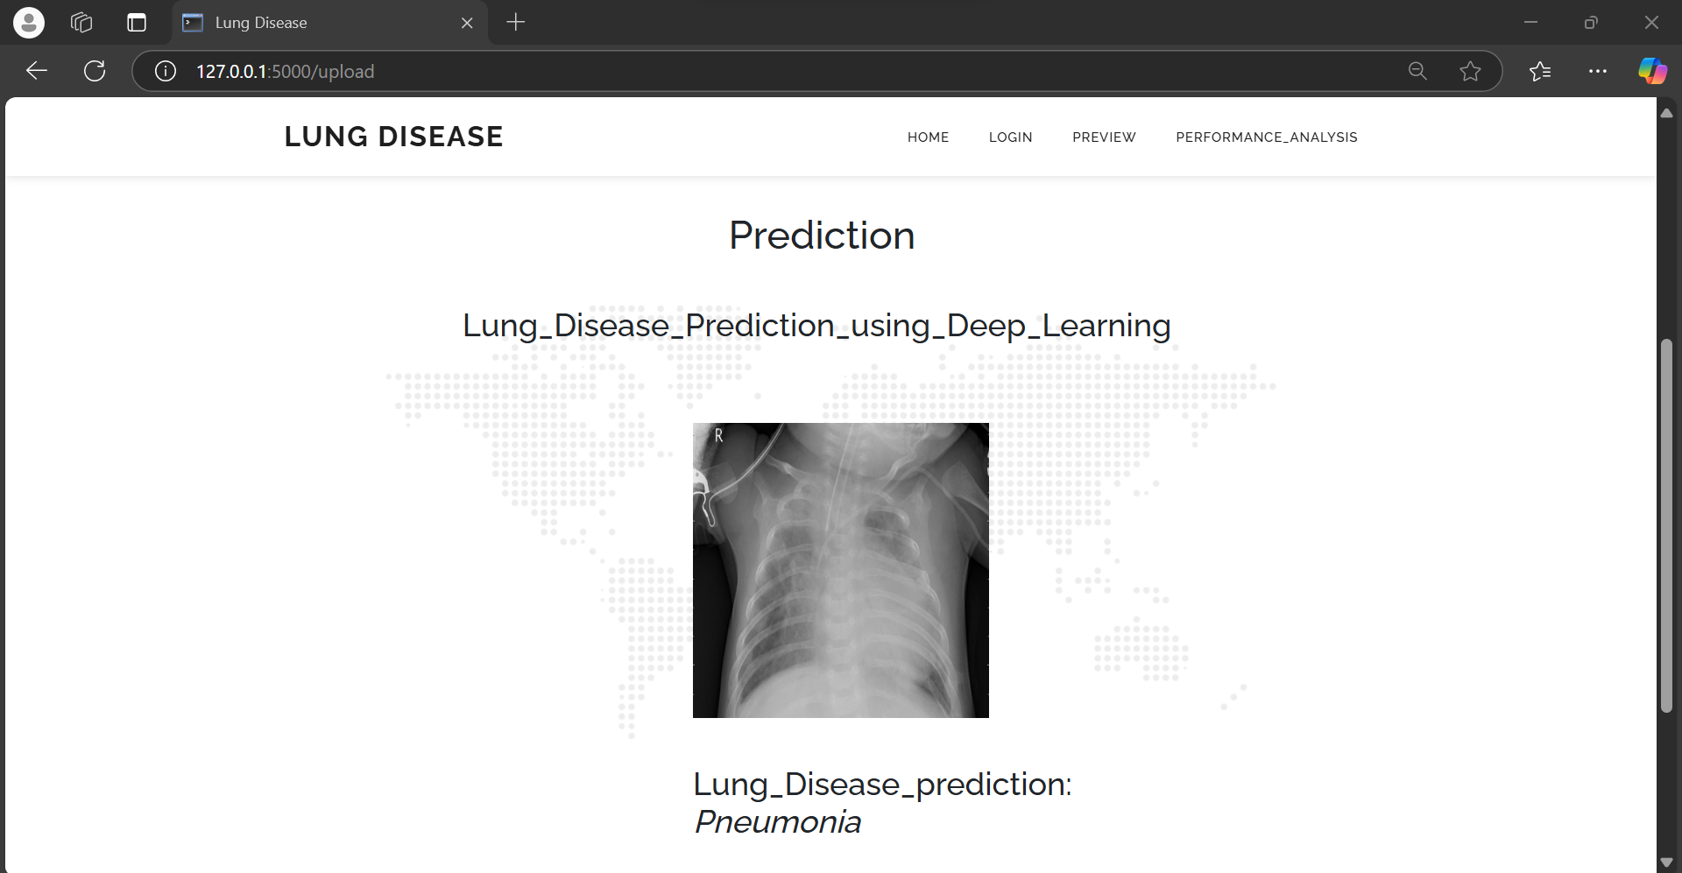
SNAPSHOT-4:

Slide 26
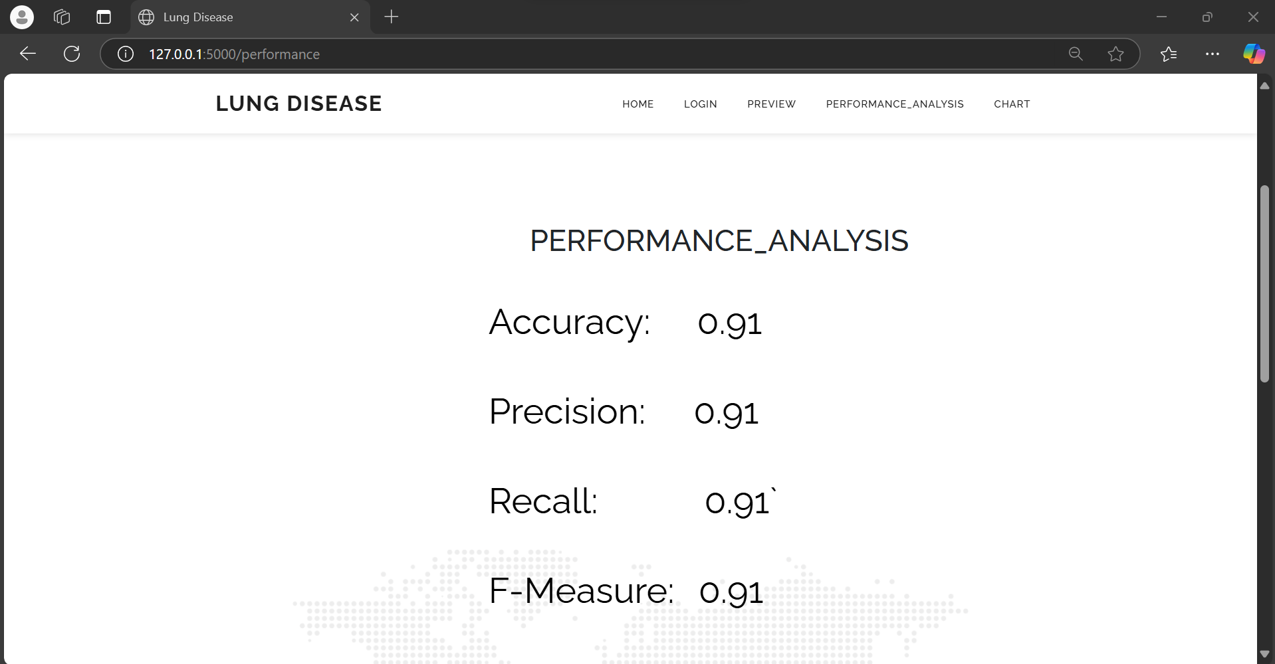
SNAPSHOT-5:

Slide 27
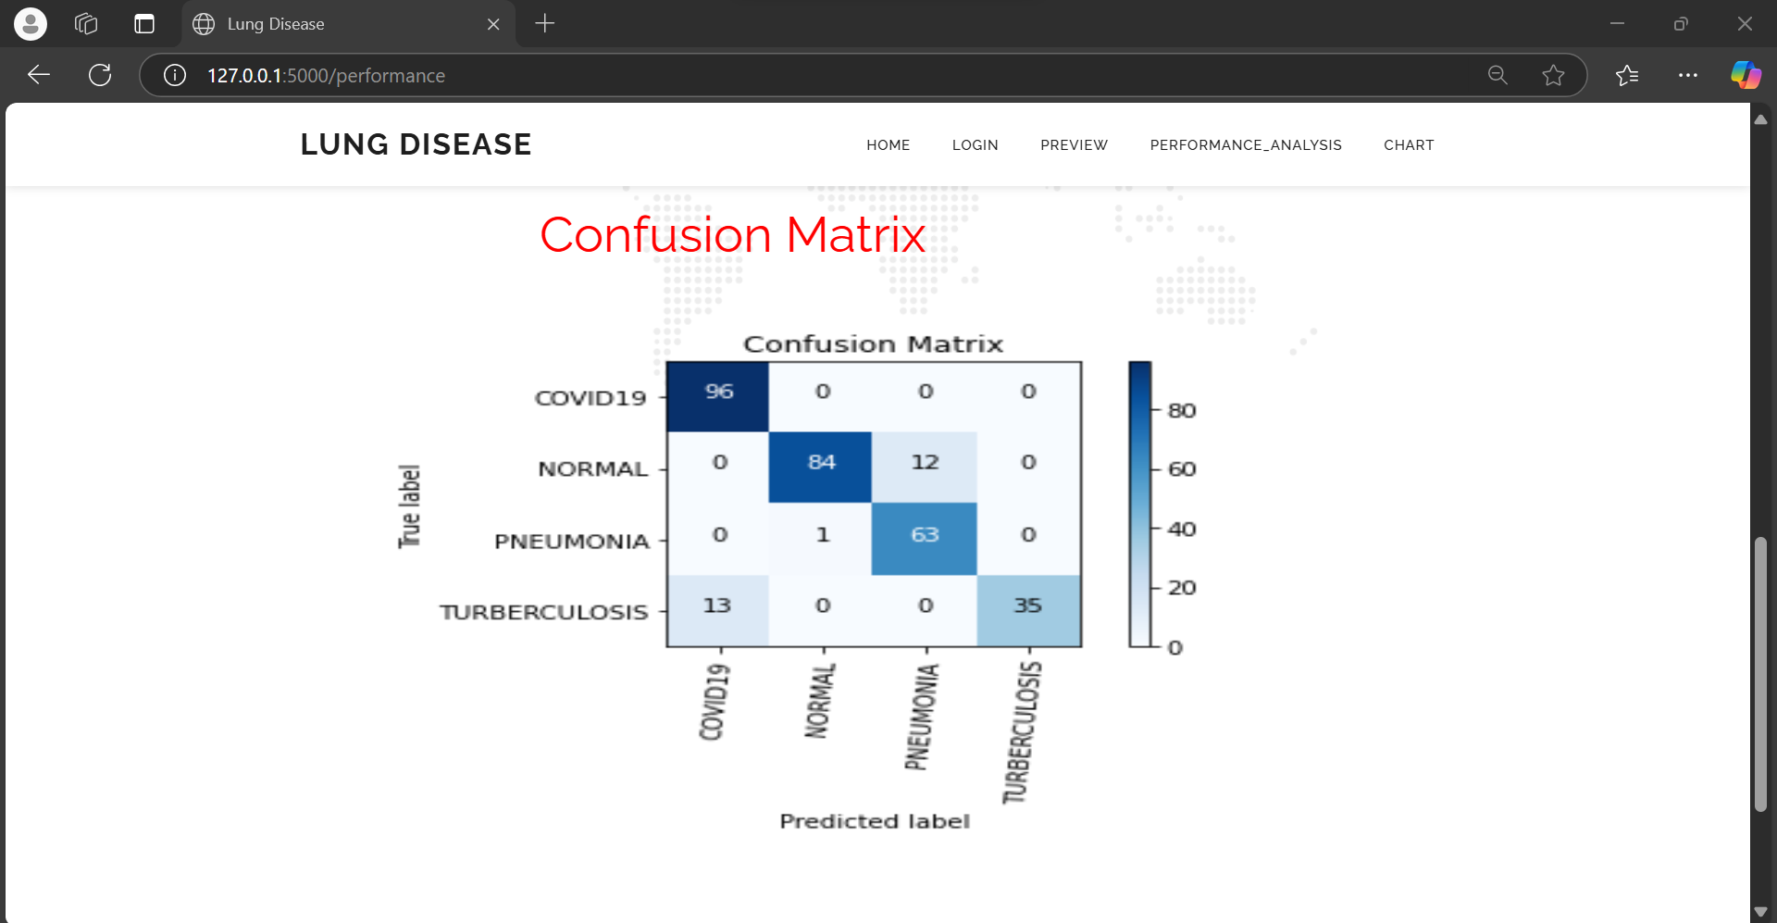
SNAPSHOT-6:

Slide 28
CONCLUSION:
In this project, the effect of the lungs of a modern patient on the various researchers and the damage to the lung is clearly explained by various researchers. Since these lung diseases have been cured the necessity of identifying this disease has become essential according to many researches. One of the main concerns of this research is to identify and select a proper data sets and technique to analyze lung diseases. Chest x-ray was selected based on the comparisons and discussions that were stated in this paper. Next a proper and suitable feature extraction algorithm was chosen since the chest x-ray may contain lots of unnecessary data. This selection was based on advantages and disadvantages of using many common algorithms. Finally, a classification algorithm was also discussed based on their characteristic qualities. In short-term research, it was seen that VGG16 Architecture added additional benefits to predict the lung diseases in advance with better results. Ultimately, lung disease can be diagnosed.

Slide 29
Any Queries? Thank You

